Slide 1
Glioblastoma Comparison of Deep Learning models.
Binary classification of RNAseq data and patient mortality.

Slide 2
Goal
Compare various models and structures and determine if DL models perform better than ML models for patient mortality.
Optimize parameters
Compare confusion matrices.
If time allows optimize number of neurons and layers.

Slide 3
Literature
Few examples use DL on RNA seq samples.
Include :
Deep learning using bulk RNA-seq dataexpands cell landscape identification in tumormicroenvironme
Xin Wang, Hongjiu Wang, Dan Liu, Na Wang, Danni He, Zheyu Wu, Xu Zhu,Xiaoling Wen, Xuhua Li, Jin Li & Zhenzhen Wang
Focused on identification of the cellular microenvironment.
Single cell RNA-seq data instead of whole RNA-seq.
Used autoencoder.
Not fully connected at first layer.
Used RELU and RELC.

Slide 4
Literature
Few examples use DL on RNA seq samples.
Include :
Deep learning-based cancer survivalprognosis from RNA-seq data: approachesand evaluations
Zhi Huang1,2,3, Travis S. Johnson2,4, Zhi Han2, Bryan Helm2, Sha Cao5, Chi Zhang5,3, Paul Salama3, Maher Rizkalla3,Christina Y. Yu2,4, Jun Cheng2,6, Shunian Xiang5,7, Xiaohui Zhan2,7, Jie Zhang5and Kun Huang2,3*
Focused on cancer survival prognosis.
Did not include GBM data.
Filtered out the bottom 20% of expression levels.
Studied various DL models
Autoencoder with COX regression.
Cox net
DeepSurv.
“Deep Learning based algorithms demonstrate superior performances than traditional machine learning based models.”

Slide 5
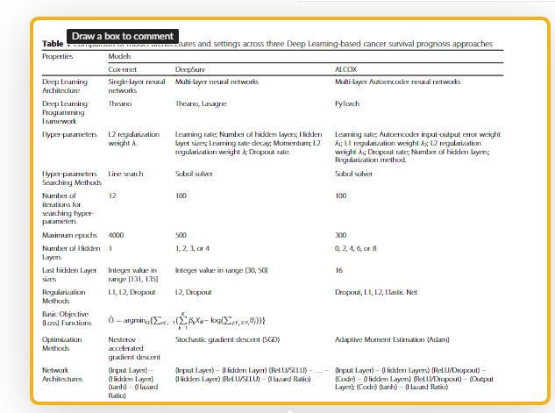
Discussion of literature
Only one paper in my search focused on survival prognosis solely on rnaseq data from tcga.
Code was not posted to github.
However, very detailed model information present.

Slide 6
Data
RNAseq data from GBM patient’s tumor samples.
Clinical information
Including gender, age, living status, treatment type etc.
~148 patients
~62000 transcript rna seq counts
Standardized via FPKM

Slide 7

Data processing
Using DAVID (Database for Annotation, Visualization and integrated Discovery) ontology, created subsets based on functional annotation grouping.
Groupings include Positive regulation of apoptosis, transport genes etc.
Total of 31 groupings
18000 genes did not belong to any grouping and were not used.
Data matrix was assembled from raw counts per patient.
Final matrix consisting of Patients on the x axis and transcript counts on the y axis.
Clinical data was then appended, with values on x and labels on y.
Y predicted value was living status living(0), diseased(1).
Column moved to last column in data matrix.
Patients with missing values were removed.
Data could not be filled in using any statistical method such as average.

Slide 8
DL Methodology
Use binary_crossentropy for loss.
Sigmoid activation in the last layer to produce 0 or 1 outcome.
Standardization: not needed as data was already standardized using FPKM.
Compared various models.
Gridsearchcv parameter optimization.
Ordinal encoding on x values.
Label encoding on y values.
0 = living, 1 diseased for y values.

Slide 9
Parameter search Gridsearchcv
Parameters optimized
batch_size = [10, 20, 40, 60, 80, 100]
epochs = [10, 50, 100]
optimizer = ['SGD', 'RMSprop', 'Adagrad', 'Adadelta', 'Adam', 'Adamax', 'Nadam']
learn_rate = [0.001, 0.01, 0.1, 0.2, 0.3]

Slide 10
Previous ML results
Data | Model | f1score |  | Predicted
Apoptosis | ML(xgbclassifier) | 90.78% |  | 1 | 2
 |  |  |  | 0 | 14
 |  |  | actual
Transport | ML(xgbclassifier) | 83.80% |  | 1 | 2
 |  |  |  | 1 | 13

Slide 11
DL models trained
Conv1D
Autoencoder
FNN
Fully Connected feed forward neural network.

Slide 12
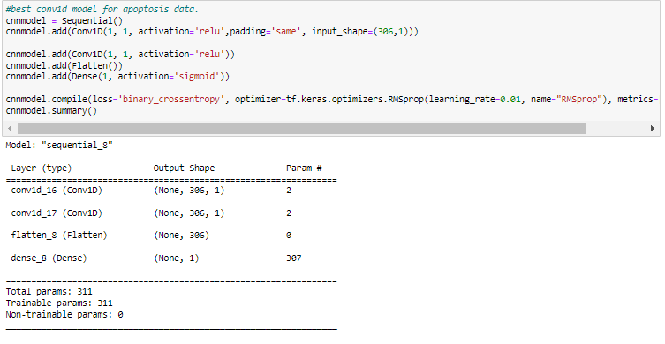
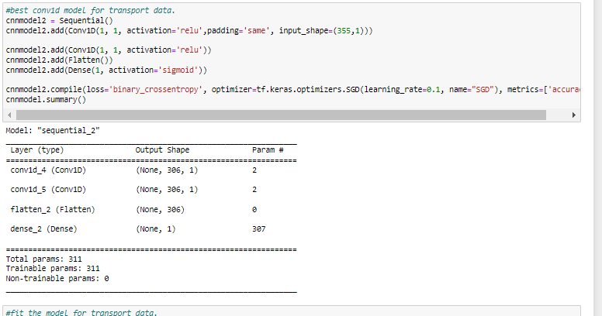
Conv1D models and parameters
Apoptosis genes
Transport genes

Slide 13
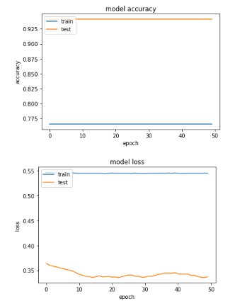
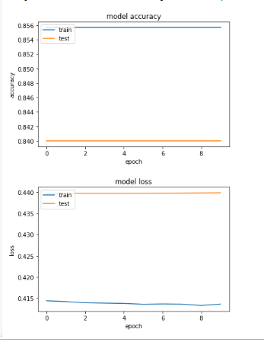
Conv1D results
Apoptosis genes
Transport genes
Data | Model | f1score |  | Predicted
Apoptosis | Conv1D | 90.66% |  | 0 | 14
 |  |  |  | 0 | 68
 |  |  | actual
Transport | Conv1D | 82.85% |  | 0 | 12
 |  |  |  | 0 | 29

Slide 14
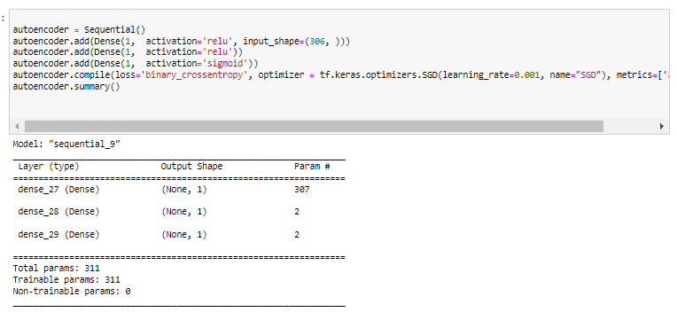
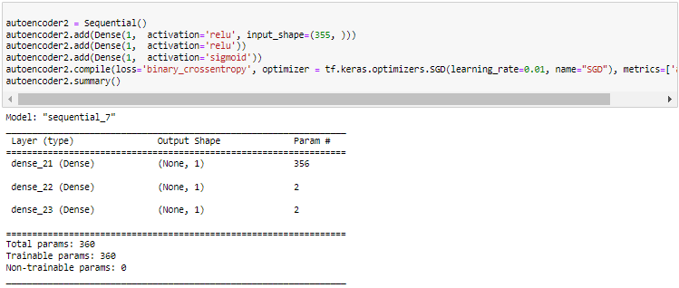
Autoencoder model and parameters
Apoptosis
Transport

Slide 15
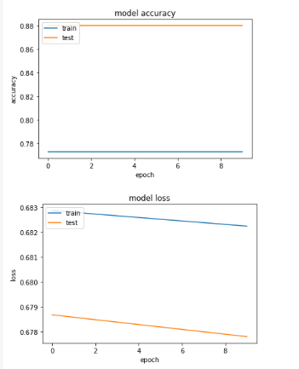
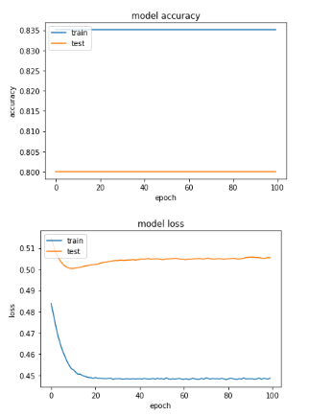
Autoencoder results
apoptosis
transport
Data | Model | f1score |  | Predicted
Apoptosis | AutoEncoder | 93.00% |  | 0 | 5
 |  |  |  | 0 | 36
 |  |  | actual
Transport | AutoEncoder | 87.67% |  | 0 | 9
 |  |  |  | 0 | 32

Slide 16
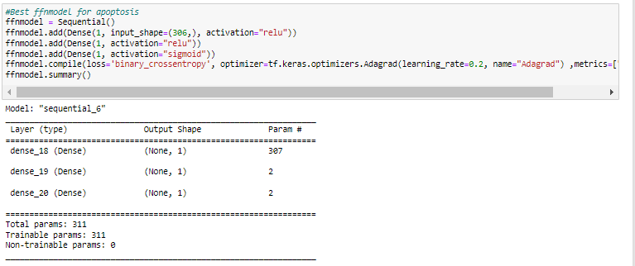
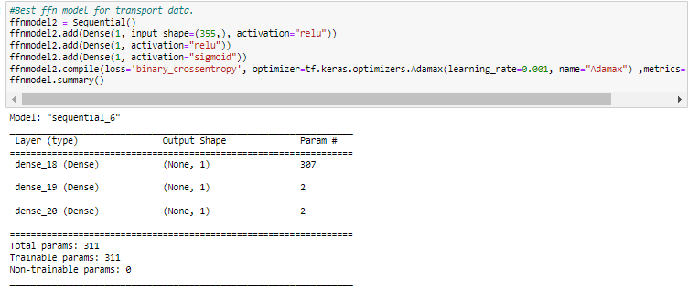
FFN model and parameters
Apoptosis
Transport

Slide 17
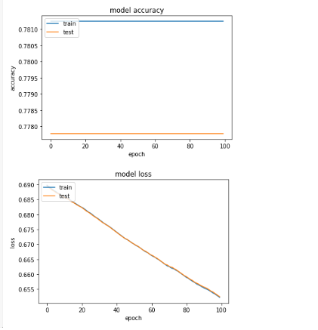
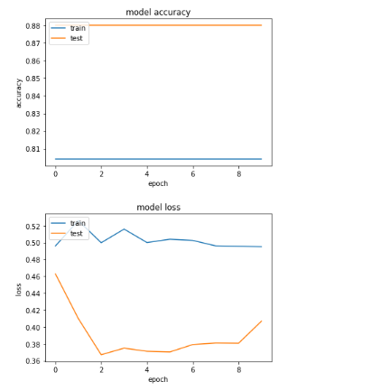
FNN results
Apoptosis
Transport
Data | Model | f1score
Apoptosis | FFN | 89.18% |  | 0 | 8
 |  |  |  | 0 | 33
 |  |  | actual
Transport | FFN | 16.21% |  | 7 | 1
 |  |  |  | 30 | 3

Slide 18
Side by side
Data | Model | f1score |  | Predicted
Apoptosis | ML(xgbclassifier) | 90.78% |  | 1 | 2
 |  |  |  | 0 | 14
 |  |  | actual
Transport | ML(xgbclassifier) | 83.80% |  | 1 | 2
 |  |  |  | 1 | 13
Data | Model | f1score |  | Predicted
Apoptosis | Conv1D | 90.66% |  | 0 | 14
 |  |  |  | 0 | 68
 |  |  | actual
Transport | Conv1D | 82.85% |  | 0 | 12
 |  |  |  | 0 | 29
Data | Model | f1score |  | Predicted
Apoptosis | AutoEncoder | 93.00% |  | 0 | 5
 |  |  |  | 0 | 36
 |  |  | actual
Transport | AutoEncoder | 87.67% |  | 0 | 9
 |  |  |  | 0 | 32
Data | Model | f1score
Apoptosis | FFN | 89.18% |  | 0 | 8
 |  |  |  | 0 | 33
 |  |  | actual
Transport | FFN | 16.21% |  | 7 | 1
 |  |  |  | 30 | 3
Best simple model

Slide 19
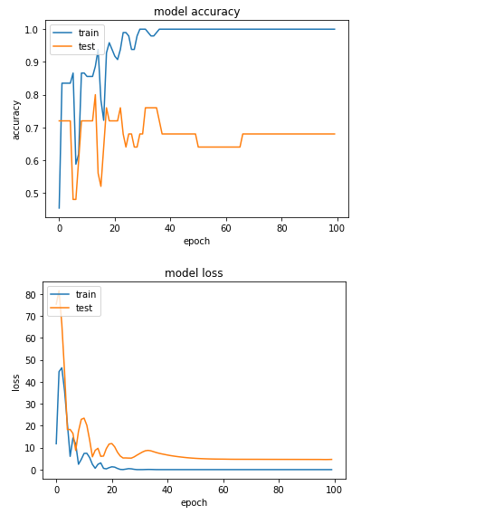
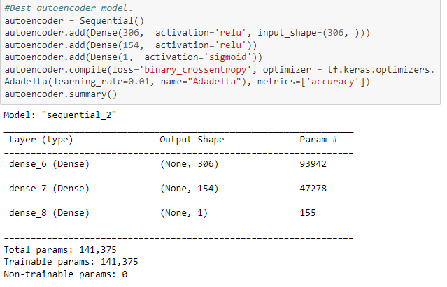
FINAL MODEL
Data | Model | f1score |  | Predicted
Apoptosis | AutoEncoder | 85.29% |  | 2 | 5
 |  |  |  | 5 | 29
 |  |  | actual

Slide 20
Limitations and issues
SHAP is currently not working for keras using tensorflow 2.
Large number of neurons and layers takes significant time to optimize.
Data is 1D so the following were not performed due to reshape problems and lack of time dimension.
RNN
Conv2d

Slide 21
Future directions
Optimize number of neurons and layers.
Add histological data to DL model using conv2d.
Use model and methods from “Deep learning-based cancer survivalprognosis from RNA-seq data: approachesand evaluations”

